Slide 1
Cumulative Statistics
Simple Cumulative commands
cumsum(x)- The cumulative sum of a vector cummax(x)- The cumulative maximum value cummin(x)- The cumulative minimum value cumprod(x)- The cumulative product

Slide 2
Examples
data2 <- c(3, 5, 7, 5 ,3, 2, 6, 8, 5, 6, 9,4, 5, 7, 3, 4)
cumsum(data2)
[1] 3 8 15 20 23 25 31 39 44 50 59 63 68 75 78 82
>cummax(data2)
[1] 3 5 7 7 7 7 7 8 8 8 9 9 9 9 9 9

Slide 3
Probability
Probability is a branch of mathematics that deals with calculating the likelihood of a given event's occurrence, which is expressed as a number between 0 and 1.

Slide 4
Probability Definition
Probability is the likelihood that an event will occur.
P(A)=a/N,
  a =number of favorable outcomes
  N=total number of outcomes
Eg: A coin flip. When you flip a coin there are only two possible outcomes, the result is either heads or tails.
P(H)=1/2, P(T)=1/2

Slide 5
Probability Distributions in R

Slide 6
Random Variable
A random variable x takes on a defined set of values with different probabilities.
    For example, if you roll a die, the outcome is random (not fixed) and there are 6 possible outcomes, each of which occur with probability one-sixth.
Roughly, probability is how frequently we expect different outcomes to occur if we repeat the experiment over and over

Slide 7
Random Variables
  There are two types of Random Variables
  Discrete random variables
  Continuous random variables.

Slide 8
Discrete Data Vs Continuous Data
  A discrete space is one in which all possible outcomes can be clearly identified and counted. Data that has a clearly finite number of values
  Die Roll: S = {1,2,3,4,5,6}
  Number of Boys among 4 children: S = {0, 1, 2, 3, 4}
  Number of baskets made on two free throws: S = {0, 1, 2}
A non-discrete space, which is called a continuous interval/space, is one in which the outcomes are too numerous to identify every possible outcome:
Height of Human Beings: S = [0.00 inches, 100.00 inches] → It is impractical to specify every possible height from 0.00 to 100.00.

Slide 9


Examples
Discrete random variables
  Number of sales
  Number of calls
  Shares of stock
  People in line
  Mistakes per page
Continuous random variables
  Length
  Depth
  Volume
  Time
  Weight

Slide 10
Probability functions
A probability function maps the possible values of x against their respective probabilities of occurrence, p(x)
p(x) is a number from 0 to 1.
The area under a probability function is always 1.
Notes:
It turns out that if you were to go out and sample many, many times, most sample statistics that you could calculate would follow a normal distribution.
What are the 2 parameters (from last time) that define any normal distribution?
Remember that a normal curve is characterized by two parameters, a mean and a variability (SD)
What do you think the mean value of a sample statistic would be? The standard deviation?
Remember standard deviation is natural variability of the population
Standard error can be standard error of the mean or standard error of the odds ratio or standard error of the difference of 2 means, etc. The standard error of any sample statistic.

Slide 11
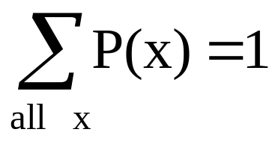
Discrete example: roll of a die
p(x)
1/6
x
1
2
3
4
5
6

Slide 12
Probability mass function (pmf)
x
p(x)
1
p(x=1)=1/6
2
p(x=2)=1/6
3
p(x=3)=1/6
4
p(x=4)=1/6
5
p(x=5)=1/6
6
p(x=6)=1/6
1.0

Slide 13
Cumulative distribution function (CDF)
1.0
P(x)
5/6
4/6
3/6
2/6
1/6
1
2
3
4
5
6
x

Slide 14
Cumulative distribution function
x
P(x≤A)
1
P(x≤1)=1/6
2
P(x≤2)=2/6
3
P(x≤3)=3/6
4
P(x≤4)=4/6
5
P(x≤5)=5/6
6
P(x≤6)=6/6

Slide 15
Practice Problem:
The number of patients seen in the ER in any given hour is a random variable represented by x. The probability distribution for x is:
x
10
11
12
13
14
P(x)
.4
.2
.2
.1
.1
Find the probability that in a given hour:
a. exactly 14 patients arrive
b. At least 12 patients arrive
c. At most 11 patients arrive
p(x=14)= .1
p(x≥12)= (.2 + .1 +.1) = .4
p(x≤11)= (.4 +.2) = .6

Slide 16
Review Question 1
If you toss a die, what’s the probability that you roll a 3 or less?
1/6
1/3
1/2
5/6
1.0

Slide 17
Review Question 1
If you toss a die, what’s the probability that you roll a 3 or less?
1/6
1/3
1/2
5/6
1.0

Slide 18

Probability Distributions for Discrete Random Variables
Say a random variable x is rolling a die.
This table gives the probabilities
x | P(x)
1 | 1/6
2 | 1/6
3 | 1/6
4 | 1/6
5 | 1/6
6 | 1/6

Slide 19
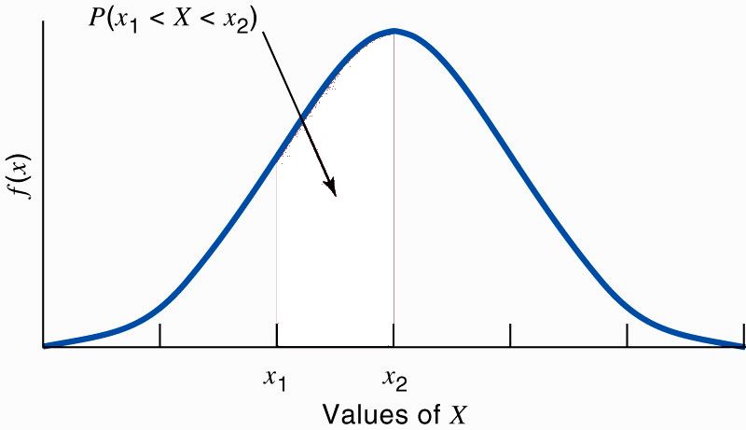
Probability Distributions for Continuous Random Variables
The probability of any event in which the outcomes are continuous is the area under the density curve for the values of X that make up the event.

Slide 20

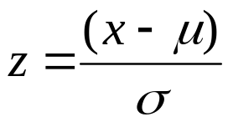
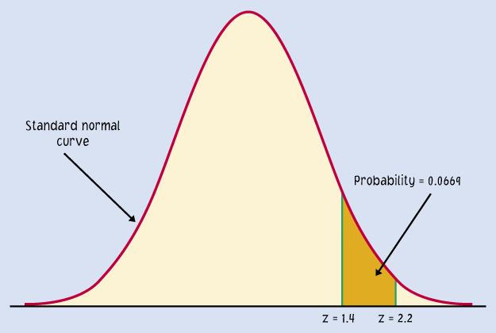
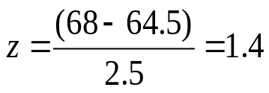
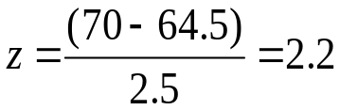
Example: The height of a sample of women has a distribution of approximately N(64.5, 2.5). What is the probability, if we pick one woman at random, that her height will be between 68 and 70 inches. I.e. P(68 < X < 70)?
N(µ, σ) =
N(64.5, 2.5)
we calculate the z-scores for 68 and 70 and determine the area between them.
For x = 68",
For x = 70",
0.9192
0.9861
The area under the curve for the interval [68" to 70"] is 0.9861 − 0.9192 = 0.0669.
I.e. The probability that a randomly chosen woman falls into this range is 0.0669.

Slide 21
Only intervals can have a non-zero probability
The probability of a single event is meaningless for a continuous random variable. In fact, the calculated value is 0.
Only intervals can have a non-zero probability.

Slide 22



Mean of a discrete random variable
For a discrete random variable X with
the probability distribution shown here,
the mean µ of X is found by multiplying each possible value of X by its probability, and then adding the products.
A basketball player shoots three free throws. The random variable X is the number of baskets successfully made.
Value of X | 0 1 2 3
Probability | 0.064 0.288 0.432 0.216
The mean µ of X is
µ = (0*0.064) + (1*0.288) + (2*0.432) + (3*0.216)
= 1.8
In other words, out of 3 throws, in the long run, this player would make 1.8 baskets.

Slide 23
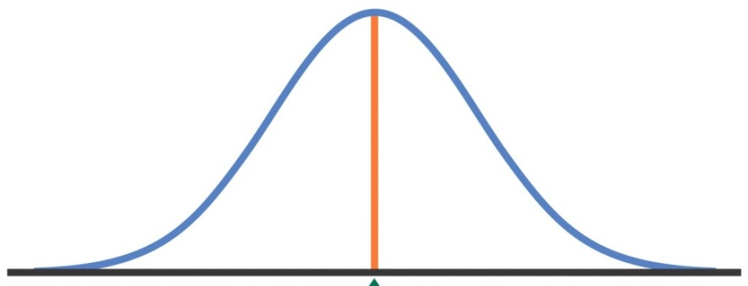
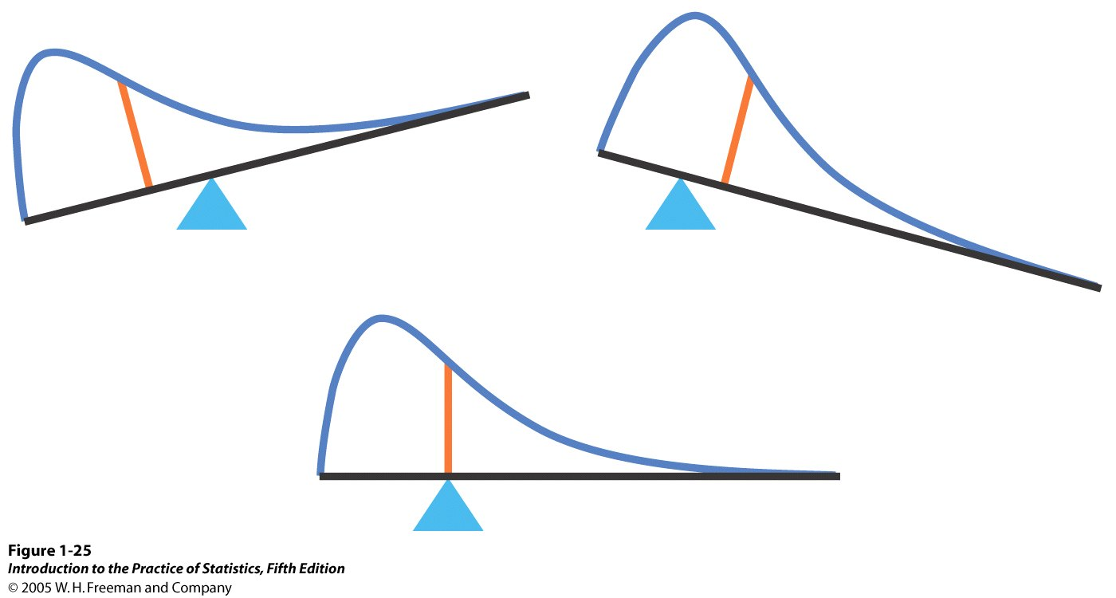
Mean of a continuous random variable
As we did with probabilities, when working with continuous data, we rely on the density curve to make various determinations.
With symmetric curves, such as the Normal curve, the mean lies at the center.
Determining the exact mean of a distribution with a skewed density curve is more complex.

Slide 24
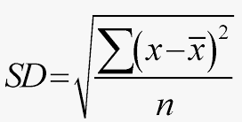
Standard Deviation of a random variable
As with expected value (i.e. mean) of a random variable, we can also calculate the standard deviation of a random variable.

Slide 25
Probability Distributions
Normal
Binomial
Poisson
Uniform

Slide 26
Normal Distribution

Slide 27
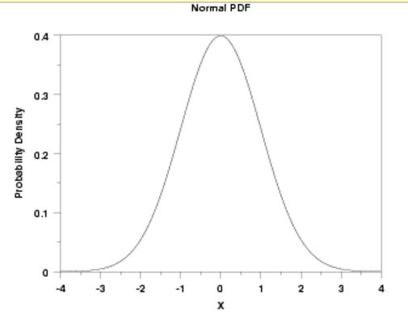


Normal Distribution- probability density function

Slide 28

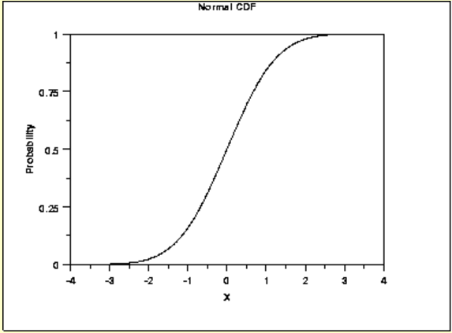
Normal Distribution- Cumulative Distribution Function
The formula for cdf is

Slide 29
R function for Normal Distribution
R has four in built functions to generate normal distribution.
They are described below.
dnorm(x, mean, sd)
pnorm(q, mean, sd)
qnorm(p, mean, sd)
rnorm(n, mean, sd)
Following is the description of the parameters used in above functions −
x, q vector of quantiles.
p vector of probabilities.
n number of observations.

Slide 30
rnorm
This function is used to generate random numbers whose distribution is normal.
It takes the sample size as input and generates that many random numbers.
Eg 1:
mean = 0 and sd = 1 are the default arguments for the dnorm function.
Eg 2: rnorm(20, mean = 50, sd = 3)
y <- rnorm(50)

Slide 31

dnorm()
This function gives height of the probability distribution at each point for a given mean and standard deviation.
As we all know the probability density for the normal distribution is:
The function dnorm returns the value of the probability density function for the normal distribution given parameters for x, μ, and σ
dnorm(0, mean = 0, sd =1) 0.3989
dnorm(2, mean = 5, sd = 3) 0.0865

Slide 32
pnorm
This function gives the probability of a normally distributed random number to be less that the value of a given number. It is also called "Cumulative Distribution Function"

Slide 33
qnorm
This function takes the probability value and gives a number whose cumulative value matches the probability value.

